Slide 1
Amity Institute of Information Technology BCA , Ist Semester Basic Mathematics- Skewness and Kurtosis Dr Sarika Jain

Slide 2
Skewness and Kurtosis

Slide 3
Skewness and Kurtosis
In statistics, skewness and kurtosis are the measures which tell about the shape of the data distribution or simply, both are numerical methods to analyze the shape of data set unlike, plotting graphs and histograms which are graphical methods. These are normality tests to check the irregularity and asymmetry of the distribution.

Slide 4
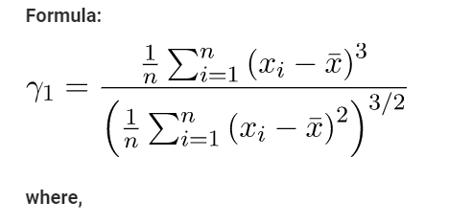
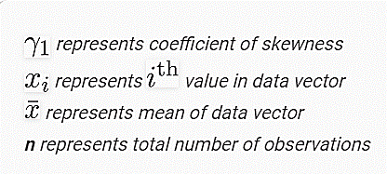
Skewness
Skewness is a statistical numerical method to measure the asymmetry of the distribution or data set. It tells about the position of the majority of data values in the distribution around the mean value.

Slide 5
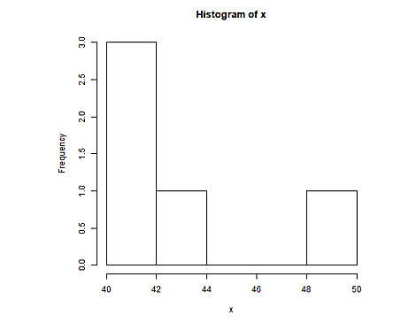
Skewness…..
There exist 3 types of skewness values on the basis of which asymmetry of the graph is decided. These are as follows:
Positive Skew
If the coefficient of skewness is greater than 0 i.e. γ1 >0, then the graph is said to be positively skewed with the majority of data values less than mean. Most of the values are concentrated on the left side of the graph.

Slide 6
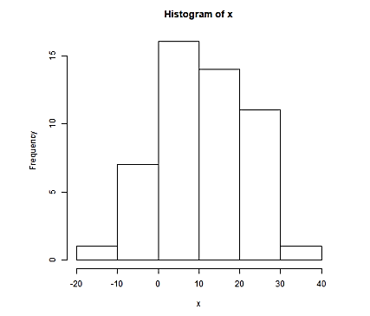
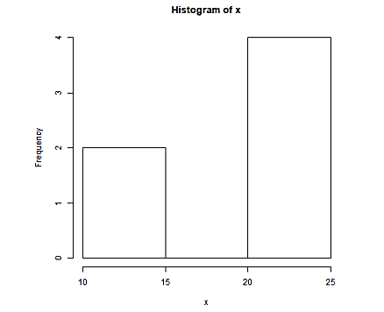
Skewness…..
Zero Skewness or Symmetric
If the coefficient of skewness is equal to 0 or approximately close to 0 i.e. γ1 = 0, then the graph is said to be symmetric and data is normally distributed.
Negatively skewed
If the coefficient of skewness is less than 0 i.e. γ1 <0, then the graph is said to be negatively skewed with the majority of data values greater than mean. Most of the values are concentrated on the right side of the graph.

Slide 7
Skewness…..
There are other approaches too to calculate skewness:
Karl Pearson’s Method
Bowley’s Method
Kelly’s Method
Method of moments

Slide 8
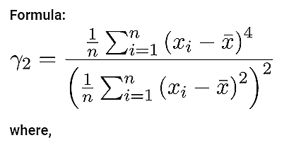
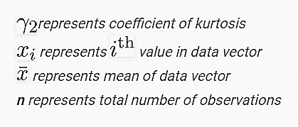
Kurtosis
Kurtosis is a numerical method in statistics that measures the sharpness of the peak in the data distribution.

Slide 9
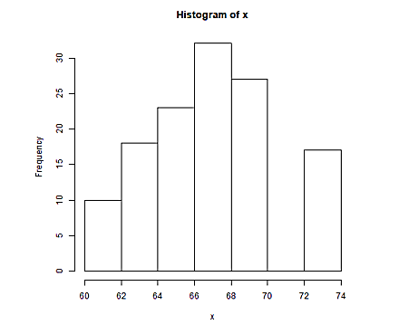
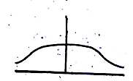
Kurtosis…..
There exist 3 types of Kurtosis values on the basis of which sharpness of the peak is measured. These are as follows:
Platykurtic
If the coefficient of kurtosis is less than 3 i.e. γ2 <3, then the data distribution is platykurtic. Being platykurtic doesn’t mean that the graph is flat-topped.

Slide 10
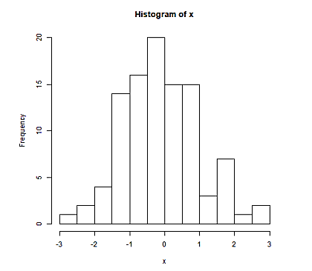
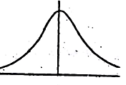
Kurtosis…..
Mesorkurtic
If the coefficient of kurtosis is equal to 3 or approximately close to 3 i.e. γ2 = 3, then the data distribution is mesokurtic. For normal distribution, kurtosis value is approximately equal to 3.

Slide 11
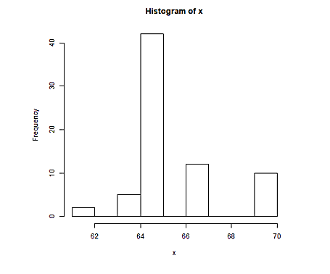
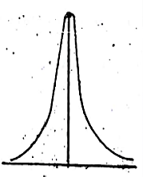
Kurtosis…..
Leptokurtic
If the coefficient of kurtosis is greater than 3 i.e. γ2 >3, then the data distribution is leptokurtic and shows a sharp peak on the graph.

Slide 12
MCQ - 1
If mean, median, and mode are all equal then distribution will be
Positive Skewed
Negative skewed
c. Symmetrical
d. None of these
Answer: iii.

Slide 13
MCQ - 2
If mean is less than mode, then distribution is
Negatively skewed
Positively skewed
Symmetrical
None of these
Answer: a).

